Slide 1
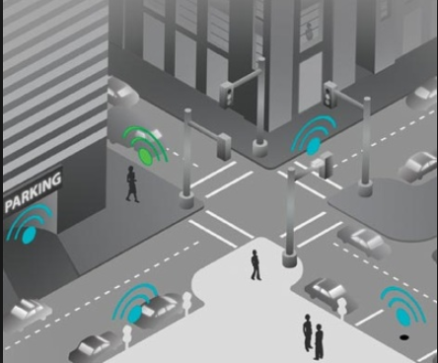
SMART PARKING
Team: PersistentSmartCoders
Ronil Malvania
Pradeep B
Abhijeet Korrane
Manish Kumar Agarwal

Slide 2
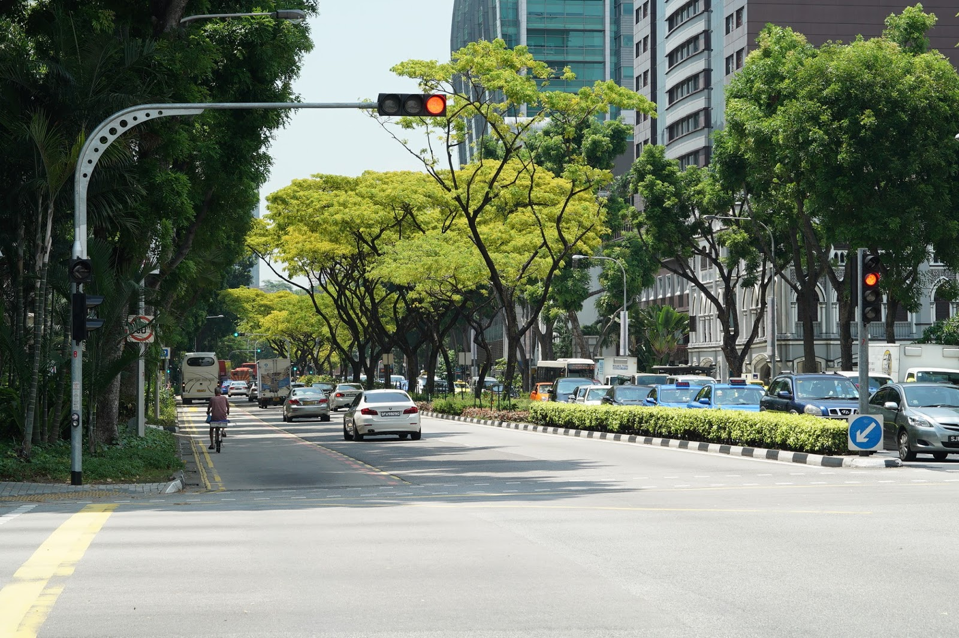
Goal of Smart Parking is to make parking easy and to reduce the fuel consumption.

Slide 3
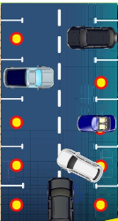
Introduction
Smart Parking is a vehicle Parking System that helps drivers to find parking space.
It consists of Sensors, apps and mobile Phone automated systems that allow to reserve parking in advance and pay via his credit card or cash.
sensors and smart parking meters track the occupancy of parking spaces and pass on the information to the drivers through their smartphone app.
These sensors also provide the parking guidance to drivers and smart parking helps in reducing traffic congestion, car, emissions and also managing demand and supply of parking.

Slide 4
Benefits of Smart Parking
Time Saving: Accurately predict and sense spot/vehicle occupancy in real-time.
Fuel Consumption: Searching for a parking space is a routine (and often frustrating) activity for many people in cities around the world. This search burns about one million barrels of the world’s oil every day.
Revenue Generation: Smart Parking enables better and real time monitoring and managing of available parking space ,resulting in significant revenue generation.
Traffic control :Help traffic in the city flow more freely leveraging IoT technology.
Emission of Co2:Smart Parking plays a major role in creating better urban environment by reducing the emission of CO2 and other pollutants

Slide 5
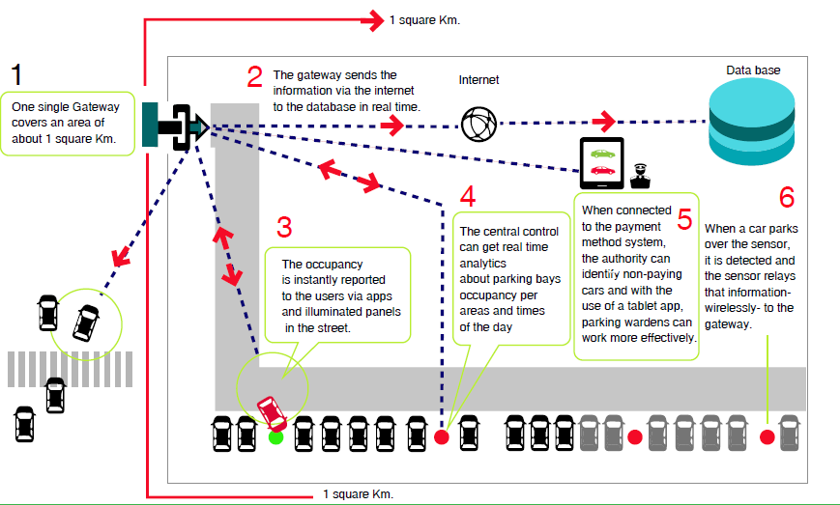
Smart Parking overview

Slide 6
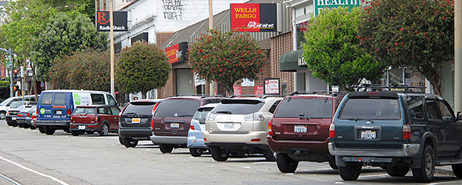
On-Street Smart Parking Management
Parking spaces located close to where people are actually going.
The study by UConn civil engineering professor Norman Garrick cites slower traffic speeds in areas with on-street parking, increasing safety for pedestrians and reducing the severity of crashes.
On-street parking uses land more efficiently than off-street surface parking, increasing the space available for high-density development
On-street Parking is inexpensive than the Commercial Parking slots.
On-street Parking will generate revenue to the government.
Referred from the wedsite: http: //www.engr.uconn.edu/~garrick/articles

Slide 7
Statistics of Revenue on-street Smart Parking
Investment for 10 Parking slots:
Raspberry PI:1*3000 RS and 10 Sensors :10*100 RS=4000 RS
>Returns per 10 slots:
10 hours per slot
Each hour 10 RS/slot
10 Slots
Per day 1000 RS
Per month :30000 RS
Per year : 360000 RS(approx)
Above revenue can be achievable with on-street Parking Management.

Slide 8
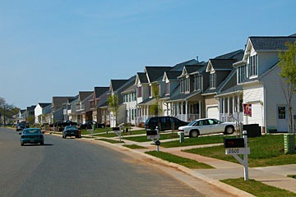
Residential Parking Management
Owner of the house can register his parking slots in the smart parking app with location, number of slots and available timings
User can book the slots through apps and online payment systems is enabled in app.
User can choose the closest parking slots as per their destination.
Residential Parking is a better solution for heavy traffic areas like K.R Market and Whitefield, Inorbit mall in Bangalore.

Slide 9
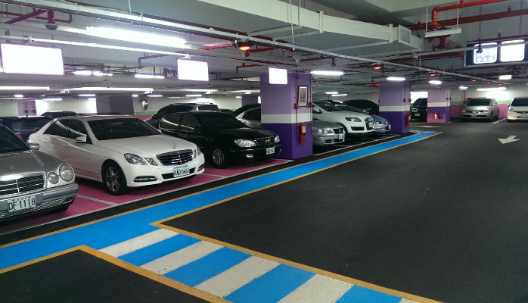
Commercial Parking Management
User can see view available slots in the smart parking app.
User can book parking slots for planned activities like movies and shopping .
Instead of searching for available slot, User can directly find the available slots in smart parking app, which will reduce fuel consumption.

Slide 10
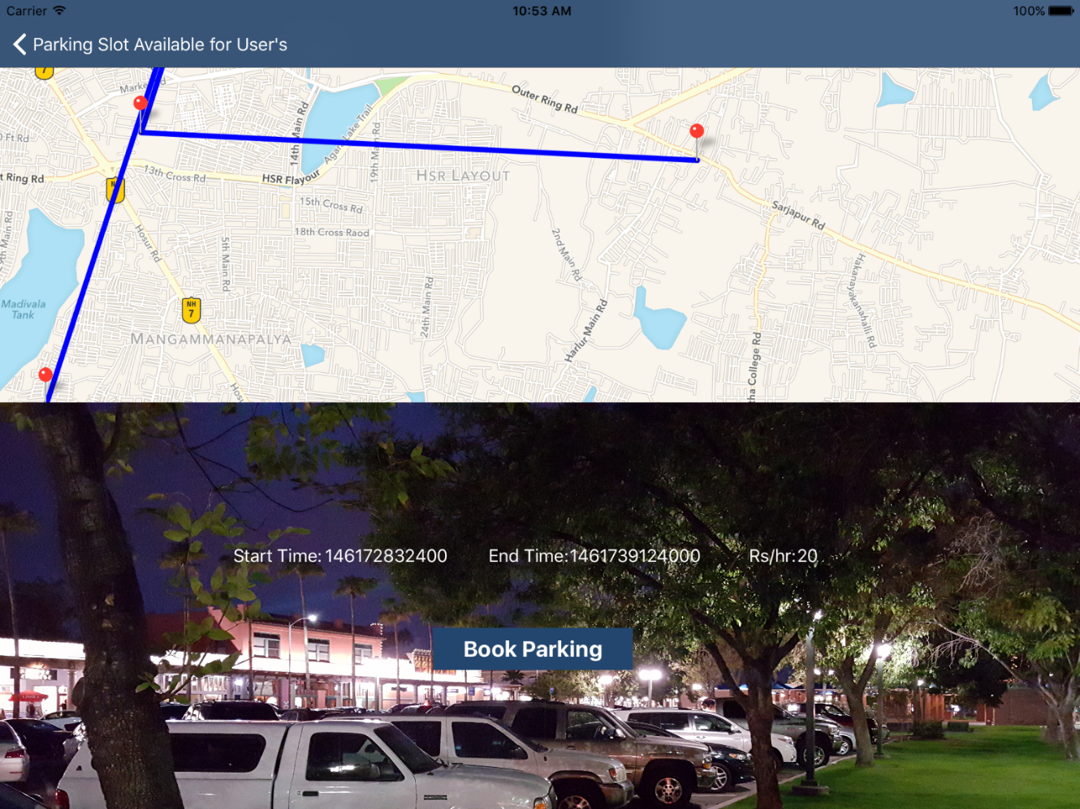
Smart Parking app
App is integrated with Google Maps.
A parking location is a specific geographic location, and describes the physical location of a parking spot.
App maintains start and end time of respective parking slots.

Slide 11
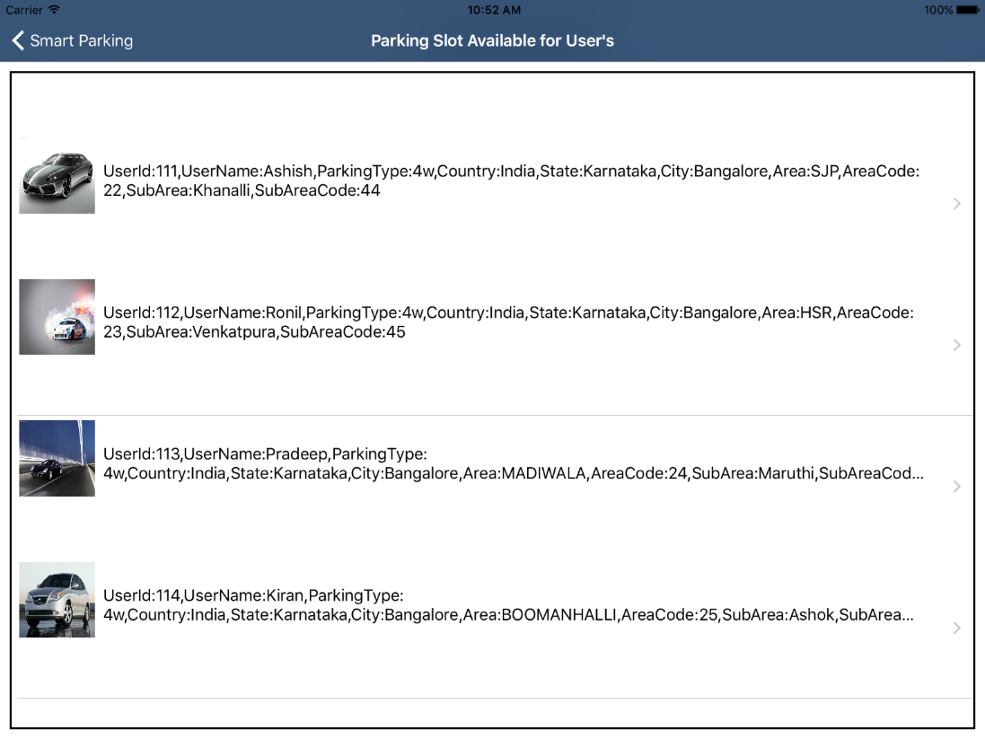
Smart Parking App
User details like location, vehicle type and subarea details are maintained in the App.

Slide 12
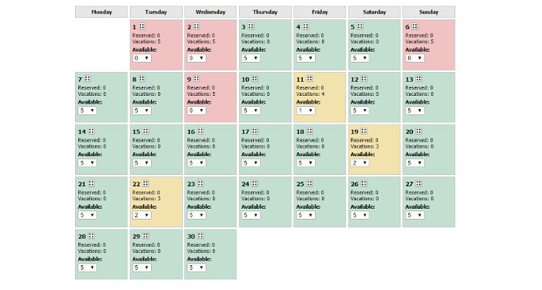
Smart Parking App
Parking listings Parking listings describe pricing and availability information for a parking location.
A parking location can have one or many parking listings
Find a convenient spot close to you Get last mile connectivity of parking and stay connected to parking updates. Navigate to nearby parking lot from your current location
Monthly Booking /On Spot Booking/Weekly Booking user allow to book the slot for monthly, weekly and spot booking for particular slot.

Slide 13
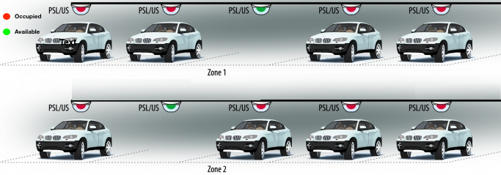
Smart Parking slot booking
Blocked slots are in red.
Vacant slots are in Green.
Go Cashless and Pay from Mobile App Integration with paytm or other 3rd party vendor and allows users to pay from mobile app.

Slide 14
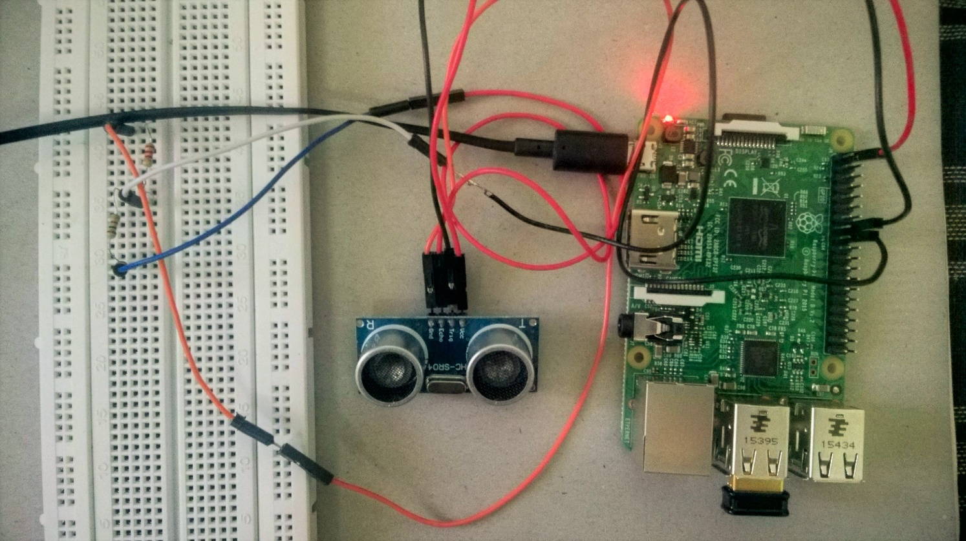
Circuit Design
Raspberry Pi 3
Development Board
HC SR-04
Ultrasonic Sensor.
It will detect the Vehicle Presence.

Slide 15
Conclusion
The major enablers or drivers for smart parking, essentially are the problems of urban livability, transportation mobility and environment sustainability.
Primarily Smart Parking technology is about enhancing the productivity levels and the service levels in operations.
Some of the underlying benefits could be lowering operating costs, while building value for customer to drive occupancy, revenues and facility value.
Finally, in the long run, smart parking can actually transform the very makeup of our urban landscapes, making them more amenable to people rather than cars.

Slide 16
Thank you

